Slide 1

Search Engine
HCL ASSIGNMENT
Search engine based on covid-19 dataset
Saurav

Slide 2


Menu
The work is divided into two parts:
Extracting Pre-defined parameters form question.
Used those parameters to search for answer in database.

Slide 3
Flow Diagram Converts normal text search to standard query search.
.
Process
Parameters
Database
Search
Question
Answer

Slide 4
1. Extraction of Parameters form question Following are parameters that needs to be found from the question Pre-defined the parameters which covers the maximum types of questions. Those are ‘case type’, ‘function’, ‘duration’, ‘place’, ‘operation’. These 5 parameters are further divided into several categories as mentioned below. So our first task is to find the category of these parameters from the question. Entity Tags:
Case Type :
Death
Recovered
Active
Confirmed (Default)
Increase rate
Function :
Maximum
Minimum
Average
sum (default)
Duration :
Interval
Place :
state
country
world (default)
Operation :
state
country
Cases(Default)

Slide 5

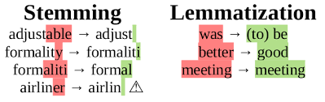
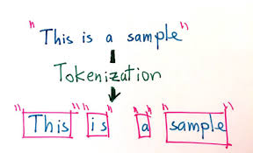
Extraction of Parameters are done with the help of:
Tokenization
Removing Stop words
Stemming and Lemmatization
Splitting a phrase, sentence, in individual words or terms. Each of these smaller units are called tokens.
Most common words of English language is removed
Lemmatization is the chopping of words to its base form by an algorithm which has the knowledge of meaning of the word in the language it belongs to

Slide 6
Process of finding different parameters Steps: Place:
Find words in text which denotes the geographical location with the help of Named Entity Recognition assigned by spaCy’s models. (Entity having tag ‘GPE’ represents Countries, cities or states)
Built the list of countries and states which are there in the dataset.
Match the found entity from the list of countries and states.
If both country and state were found then we give priority to state i.e we do searching according to state.
If nothing were found then by default place will be assigned as ‘World’
Duration:
We find range of date from the text.
Find the date with the help of SUTime library in python. SUTime was developed using TokensRegex, a generic framework for defining patterns over text and mapping to semantic objects.
Sometimes the date may not be found in required format i.e xxxx-xx-xx. Therefore we further use the regular expression to extract date in this format. (re.search('....-..-..', s)). [s: output from SUTime]
If no start and end date were found then by default start date=2020-01-22 and end_date=2020-12-20. (because the dataset contains the dataset of this duration)
Extracted the duration in this format {‘begin’: xxxx-xx-xx , ‘end’: xxxx-xx-xx}

Slide 7
Case Type:
Find case type like death, recover, active, confirm or increase rate.
For this we match the tokens of text (after eliminating the place and date tokens) with these words (Case types) or words similar to these (lemmatized form of similar words).
'recover' : ['recover’, 'recovery’, 'cure’, 'heal’]
'death' : ['death’, 'fatality’, 'fatal’, 'demise’, 'decease’, 'die’, 'expire’]
'confirm': ['confirm’]
'active' : ['active', 'live']
If nothing found then by default we set the case type to confirmed.
Function:
This gives the information about the task we are interested like finding Minimum, Maximum, Average or Sum.
We match the tokens of text (after eliminating the place, date and case_type tokens) with these words (Minimum, Maximum, Average and Sum) or words similar to these (lemmatized form of similar words).
'maximum' : ['maximum', 'high', 'max', 'maximal', 'most’],
'minimum' : ['minimum', 'low', 'least', 'min’],
'average' : ['average', 'avg', 'normally', 'usually', 'generally']
If nothing is found then by default we assign the function as sum.
Similar words in lemmatized form
Similar words in lemmatized form

Slide 8
Operation:
This gives the information about what we have to find, whether we have to find the number of cases or country or state.
If ‘country’ or ‘state’ (or similar words as stated below ) appears in the text as object (This is done by POS tagging) the operation will be assigned as ‘country’ or ‘state’ .
Else the Operation will be assigned as cases (here we have to find the number of cases)
'state' : ['state', 'province’],
'country' : ['country', 'region', 'nation', 'place']
Similar words in lemmatized form
Place
Process
Duration
Parameters
Case type
Function
Operation

Slide 9

After the process we get the parameters in the required format.
question: 'total number of new cases found in Greece between april to september?’
Parameters
{'Place': {'no_match': [], 'states': [], 'countries': ['greece']},
'Time Duration': {'begin': '2020-04-01', 'end': '2020-09-31'},
'Case Type': 'confirm',
'Function Type': 'sum',
'Operation Type': 'cases'}

Slide 10
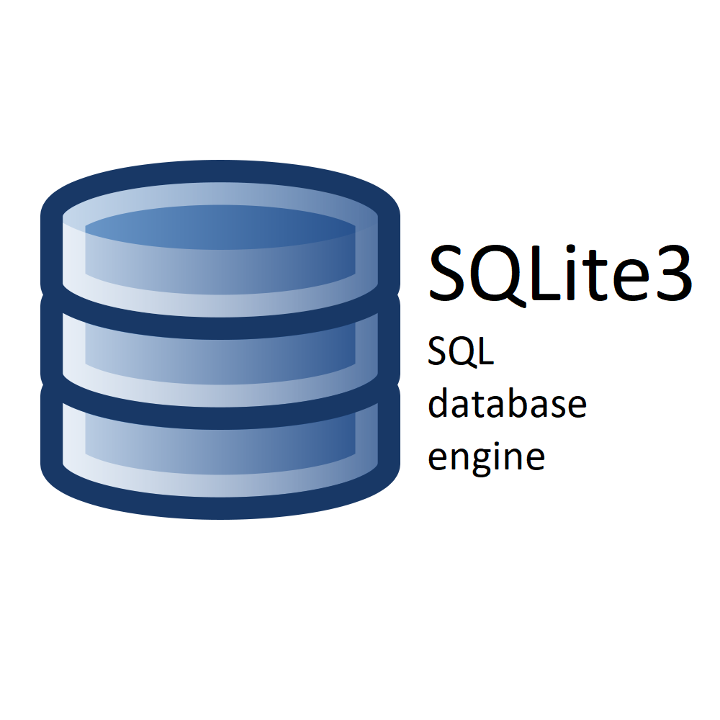
2. Query search using the parameters:
Used sqllite3 in python
Created a database named “covid19”
Converted CSV files into tables.
Based on the parameters we generated corresponding SQL query.
Done the query search using SQLlite3 in python from the database.

Slide 11
state having maximum number of cases in China?
Parameters:
{'query': 'state having maximum number of cases in China?',
'Place': {'no_match': [], 'states': [], 'countries': ['china']},
'Time Duration': {'begin': '2020-01-01', 'end': '2020-12-31'},
'Case Type': 'confirm',
'Function Type': 'maximum',
'Operation Type': 'state’}
SQL Query
SELECT Province_State FROM (SELECT Province_State, (MAX(sum)-MIN(sum)) as cases FROM (SELECT Date, Province_State, SUM(Confirmed) as sum FROM timeseries WHERE Country_Region = 'China' AND Date BETWEEN '2020-01-01' AND '2020-12-31' GROUP BY Date, Province_State) GROUP BY Province_State) WHERE cases = (SELECT MAX(cases) from (SELECT Province_State, (MAX(sum)-MIN(sum)) as cases FROM (SELECT Date, Province_State, SUM(Confirmed) as sum FROM timeseries WHERE Country_Region = 'China' AND Date BETWEEN '2020-01-01' AND '2020-12-31' GROUP BY Date, Province_State) GROUP BY Province_State));
Answer:
Hubei

Slide 12

Results:
total number of cases found in Colombia till july?
{'Place': {'no_match': [], 'states': [], 'countries': ['colombia']},
'Time Duration': {'begin': '2020-07-01', 'end': '2020-07-31'},
'Case Type': 'confirm',
'Function Type': 'sum',
'Operation Type': 'cases'}
193499
total number of deaths in world?
{'Place': {'no_match': [], 'states': [], 'countries': []},
'Time Duration': {'begin': '2020-01-01', 'end': '2020-12-31'},
'Case Type': 'death',
'Function Type': 'sum',
'Operation Type': 'cases'}
1693188

Slide 13
country having maximum number of recovery cases?
{'Place': {'no_match': [], 'states': [], 'countries': []},
'Time Duration': {'begin': '2020-01-01', 'end': '2020-12-31'},
'Case Type': 'recover',
'Function Type': 'maximum',
'Operation Type': 'country'}
India
what is the maximum increase rate found till now?
{'Place': {'no_match': [], 'states': [], 'countries': []},
'Time Duration': {'begin': '2020-01-01', 'end': '2020-12-31'},
'Case Type': 'increase rate',
'Function Type': 'maximum',
'Operation Type': 'cases'}
90.570550051247

Slide 14
state having maximum number of cases in China?
{'Place': {'no_match': [], 'states': [], 'countries': ['china']},
'Time Duration': {'begin': '2020-01-01', 'end': '2020-12-31'},
'Case Type': 'confirm',
'Function Type': 'maximum',
'Operation Type': 'state'}
Hubei
state having maximum number of recovery cases till july in Canada?
{'Place': {'no_match': [], 'states': [], 'countries': ['canada']},
'Time Duration': {'begin': '2020-07-01', 'end': '2020-07-31'},
'Case Type': 'recover',
'Function Type': 'maximum',
'Operation Type': 'state'}
Alberta

Slide 15

Question: state having maximum number of recovery cases in US?
{'Place': {'no_match': [], 'states': [], 'countries': ['us']},
'Time Duration': {'begin': '2020-01-01', 'end': '2020-12-31'},
'Case Type': 'recover',
'Function Type': 'maximum',
'Operation Type': 'state’}
Recovered Data is not provided for US.

Slide 16


